Slide 1
Introduction to Computer Simulation of Physical Systems (Lecture 8) The Chaotic Motion of Dynamical Systems (CONTINUED)
PHYS 3061

Slide 2
Higher-Dimensional Models
So far we have discussed the logistic map as a mathematical model that has some remarkable properties and produces some interesting computer graphics.
In this section we discuss some two and three-dimensional systems.

Slide 3
We begin with a two-dimensional map and consider the sequence of points (x_{n}, y_{n}) generated by
x_{n+1} = y_{n + 1} − ax_{n}²
y_{n+1} = bx_{n}.
The map was proposed by H´enon
who was motivated by the relevance of this dynamical system to the behavior of asteroids and satellites.
You can write a program to iterate it for a = 1.4 and b = 0.3 and plot 10⁴ iterations starting from x₀ = 0, y₀ = 0.

Slide 4
One of the earliest indications of chaotic behavior
an atmospheric model developed by Lorenz.
His goal
describe the motion of a fluid layer that is heated from below.
The result is convective rolls, where the warm fluid at the bottom rises, cools off at the top, and then falls down later.
Lorenz simplified the description by restricting the motion to two spatial dimensions.
This situation has been realized experimentally and is known as a Rayleigh-Benard cell.

Slide 5
The equations
that Lorenz obtained are
dx/dt = −σx + σy
dy/dt= −xz + rx − y
dz/dt = xy − bz
where x is a measure of the fluid flow velocity circulating around the cell,
y is a measure of the temperature difference between the rising and falling fluid regions,
and z is a measure of the difference in the temperature profile between the bottom and the top from the normal equilibrium temperature profile.

Slide 6
The dimensionless parameters σ, r, and b are determined by
various fluid properties, the size of the Raleigh-Benard cell, and the temperature difference in the cell.
Note that the variables x, y, and z have nothing to do with the spatial coordinates, but are measures of the state of the system.

Slide 7
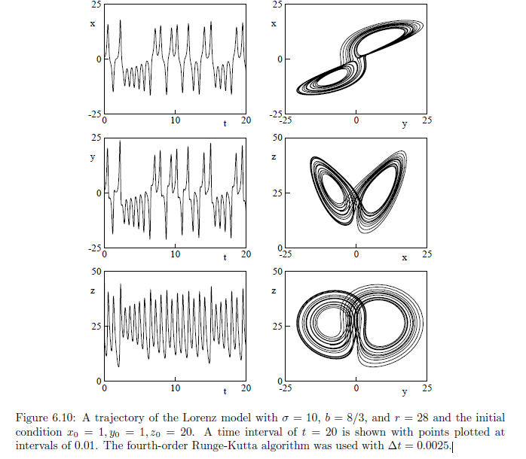

Slide 8
The application of the Lorenz equations to weather prediction has led to a popular metaphor known as the butterfly effect.
This metaphor is made even more meaningful by inspection of Figure.
The “butterfly effect” often is ascribed to Lorenz (see Hilborn).

Slide 9
In a 1963 paper he remarked that:
“One meteorologist remarked that if the theory were correct, one flap of a seagull's wings would be enough to alter the course of the weather forever."
By 1972, the sea gull had evolved into the more poetic butterfly and the title of his talk was “Predictability: Does the flap of a butterfly’s wings in Brazil set off a tornado in Texas?”

Slide 10
Perspective
As the many books and review articles on chaos can attest, it is impossible to discuss all aspects of chaos in a single chapter.
Chaotic systems are closely related to fractals.
One of the characteristics of chaotic dynamics is that the resulting attractors often have an intricate geometrical structure.

Slide 11
The most general ideas that we have discussed in this chapter:
simple systems can exhibit complex behavior and that chaotic systems exhibit extreme sensitivity to initial conditions.
We also have learned that computers allow us to explore the behavior of dynamical systems and visualize the numerical output.

Slide 12
Electrodynamics

Slide 13
Static Charges
Goal: to understand the electric field E(r) at the point r due to N point charges q1, q2, . . . , qN at fixed positions r1, r2, . . . , rN.
We know that E(r) satisfies a superposition principle and is given by
E(r) = KΣq_{i}|r − r_{i}|⁻³ (r − ri),
where ri is the fixed location of the ith charge and K is a constant that depends on our choice of units.

Slide 14
One of the difficulties associated with electrodynamics is the competing systems of units.
In the SI (or rationalized MKS) system of units, the charge is measured in coulombs (C) and the constant K is given by
K =1/(4πϵ₀) ≈ 9.0 × 10⁹ N · m²/C².
The constant ϵ₀ is the electrical permittivity of free space.

Slide 15
This choice of units is not convenient for computer programs because K ≫ 1.
Another popular system of units is the Gaussian (cgs) system for which the constant K is absorbed into the unit of charge so that K = 1.
Charge is in electrostatic units or esu.

Slide 16
One feature of Gaussian units is that the electric and magnetic fields have the same units.
For example, the (Lorentz) force on a particle of charge q and velocity v in an electric field E and a magnetic field B has the form
F = q(E +(v/c)× B). (Gaussian unit)
These virtues of the Gaussian system of units lead us to adopt this system for this chapter even though SI units are used in introductory texts.

Slide 17
Electric Fields
The electric field is an example of a vector field
a vector quantity at every point in space.
To visualize this field
to divide space into a discrete grid
to draw arrows in the direction of E at the vertices of this grid.
The length of the arrow can be chosen to be proportional to the magnitude of the electric field.
Any other solutions to show the electric field?

Slide 18
Another possibility is to use color or gray scale to represent the magnitude.

Slide 19
Using an arrow’s color rather than its length to represent field strength produces
a more effective representation of vector fields over a wider dynamic range,
the Vector2DFrame class in the Open Source Physics frames package uses the color representation.
We’ll skip the code because it’s mostly on the graphical representation, which is not the main focus of this class.
if you are interested, you can find the code on the textbook.

Slide 20
Electric Potential
It often is easier to analyze the behavior of a system using energy rather than force concepts.
Scalar vs. vectors
We define the electric potential V (r) by the relation
V (r2) − V (r1) = −∫ _{r1}^{r2} E · dr,
Or E(r) = −∇V (r).

Slide 21
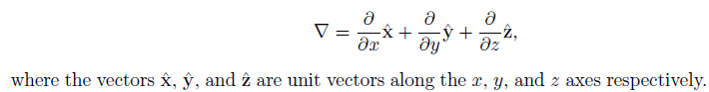
Only differences in the potential between two points have physical significance.
The gradient operator ∇ is given in Cartesian coordinates by

Slide 22
If V depends only on the magnitude of r, then E(r) = −∇V (r) becomes E(r) = −dV (r)/dr.
Recall that V (r) for a point charge q relative to a zero potential at infinity is given by
V (r) =q/r. (Gaussian units)
How do we plot the potential?

Slide 23
The surface on which the electric potential has an equal value everywhere is called an equipotential surface (a curve in two dimensions).
Because E is in the direction in which the electric potential decreases most rapidly, the electric field lines are orthogonal to the equipotential surfaces at any point.

Slide 24
The Open Source Physics frames package contains the Scalar2DFrame class to provide graphical representations of scalar fields (see Appendix 9B).
The following code fragment shows how to calculate the electric potential at a grid point.

Slide 25
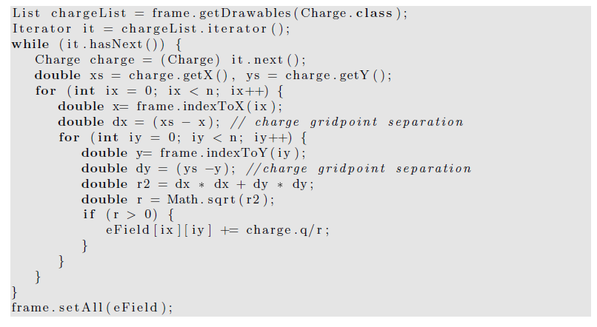

Slide 26
Numerical Solutions of Boundary Value Problems
In Section 10.1 we found the electric fields and potentials due to a fixed distribution of charges.
Suppose that we do not know the positions of the charges and instead know only the potential on a set of boundaries surrounding a charge-free region.
This information is sufficient to determine the potential V (r) at any point within the charge-free region.

Slide 27
The direct method of solving for V (x, y, z) is based on Laplace’s equation which can be expressed in Cartesian coordinates as
∇²V (x, y, z) ≡ ∂²V/∂x² +∂²V/∂y² +∂²V/∂z² = 0.
The problem is to find the function V (x, y, z) that satisfies the above equation and the specified boundary conditions.

Slide 28
This type of problem is an example of a boundary value problem.
Because analytical methods for regions of arbitrary shape do not exist, the only general approach is to use numerical methods.
Laplace’s equation is not a new law of physics, but can be derived directly and the relation ∇ · E = 0 or indirectly from Coulomb’s law in regions of space where there is no charge.

Slide 29
For simplicity, we consider only two-dimensional boundary value problems for V (x, y).
We use a finite difference method and divide space into a discrete grid of sites located at the coordinates (x, y).
In the absence of a charge at (x, y), the discrete form of Laplace’s equation satisfies the relation
V (x, y) ≈ ¼ [V (x + Δx, y) + V (x − Δx, y) + V (x, y + Δy) + V (x, y − Δy)], (equation 1)

Slide 30
where V (x, y) is the value of the potential at the site (x, y).
This Equation says that V (x, y) is the average of the potential of its four nearest neighbor sites.
This remarkable property of V (x, y) can be derived by approximating the partial derivatives in Laplace’s equation by finite differences.

Slide 31
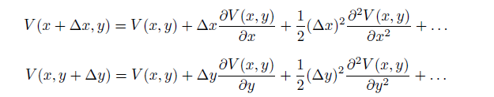
the finite difference equation for V (x, y) using the second-order Taylor expansion:

Slide 32
Equation 1, a finite difference form of Laplace’s equation, is consistent with Coulomb’s law,
we adopt equation 1 as the basis for computing the potential for systems for which we cannot calculate the potential directly.

Slide 33
In particular, we consider problems
where the potential is specified on a closed surface that divides space into interior and exterior regions
In which the potential is independently determined.
For simplicity, we consider only two-dimensional geometries.
The approach, known as the relaxation method, is based on the following algorithm:

Slide 34
1. Divide the region of interest into a rectangular grid spanning the region. The region is enclosed by a surface (curve in two dimensions) with specified values of the potential along the curve.
2. Assign to a boundary site the potential of the boundary nearest the site.
3. Assign all interior sites an arbitrary potential (preferably a reasonable guess).

Slide 35
4. Compute new values for the potential V for each interior site. Each new value is obtained by finding the average of the previous values of the potential at the four nearest neighbor sites.
5. Repeat step (4) using the values of V obtained in the previous iteration. This iterative process is continued until the potential at each interior site is computed to the desired accuracy.

Slide 36
As the algorithm loops through the grid sites, it first checks if each grid site is a conductor.
If it is, the site is skipped.
If not, a new potential is calculated and assigned to the proper element in the potential array.
A local variable named maximumError keeps track of the maximum difference between the potential at a site and the average potential of the four neighbors.
This variable is used to determine the end of the simulation.

Slide 37
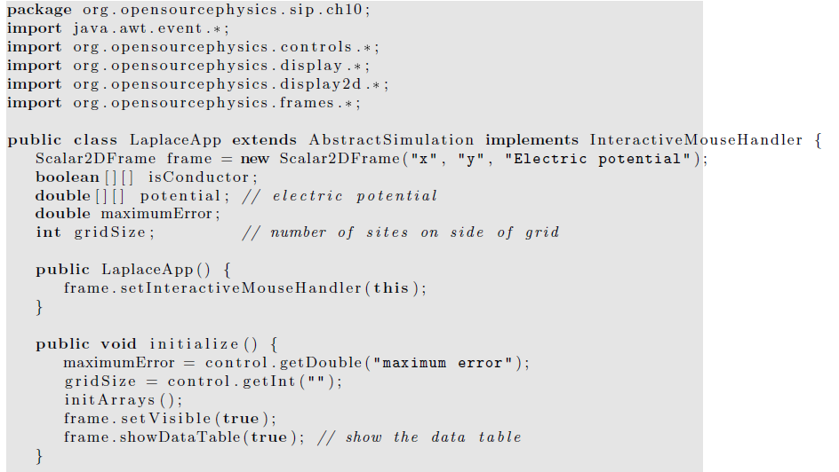

Slide 38
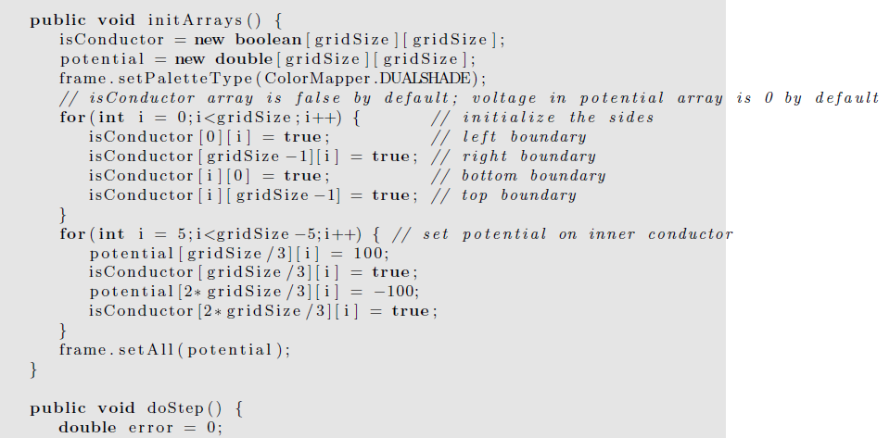

Slide 39
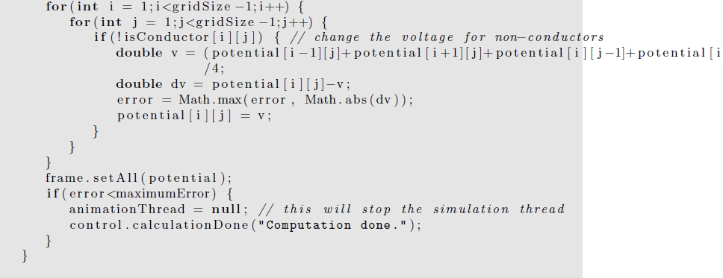
][j+1])

Slide 40
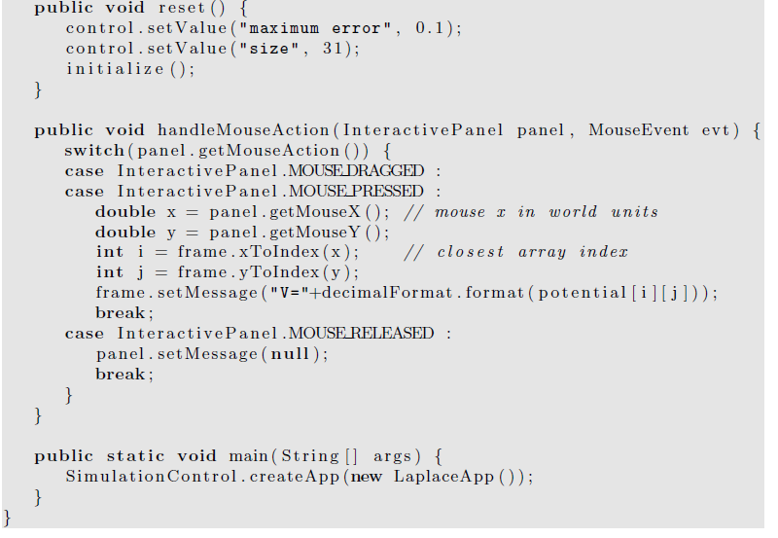

Slide 41
We can improve the relaxation method by using an overrelaxation method that updates the new potential as follows:
V_{new}(x, y) = wV_{ave}(x, y) + (1 − w)V (x, y),
where V_{ave}(x, y) is the average of the potential of the four neighbors of (x, y).
The overrelaxation parameter w is in the range 1 < w < 2.
The effect of w is to cause the potential to change by a greater amount than in the simple relaxation procedure.

Slide 42
Laplace’s equation holds only in charge-free regions. If there is a charge density ρ(x, y, z) in the region, we need to use Poisson’s equation which can be written as
∇²V (x, y, z) ≡ ∂²V/∂x² +∂²V/∂y² +∂²V/∂z² = −4πρ(r).
where ρ(r) is the charge density.

Slide 43
The difference form of Poisson’s equation is given in two dimensions
V (x, y) ≈ 1/4[V (x + Δx, y) + V (x − Δx, y) + V (x, y + Δy) + V (x, y − Δy)]+1/4ΔxΔy 4πρ(x, y).
Note that the product ρ(x, y)ΔxΔy is the total charge in a Δx × Δy region centered at (x, y).

Slide 44
Random Walk Solution of Laplace's Equation
The relation of the average potential can be given by a probabilistic interpretation in terms of random walks.
Suppose that many random walkers are at the site (x, y) and each walker “jumps” to one of its four neighbors (on a square grid) with equal probability p = 1/4.
the average potential found by the walkers after jumping one step is the potential at (x, y).
This relation generalizes to walkers that visit a site on a closed surface with fixed potential.

Slide 45
The random walk algorithm for computing the solution to Laplace’s equation can be stated as:
1. Begin at a point (x, y) where the value of the potential is desired, and take a step in a random direction.
2. Continue taking steps until the walker reaches the surface. Record Vb(i), the potential at the boundary site i. A typical walk is shown in next Figure.

Slide 46
3. Repeat steps (1) and (2) n times and sum the potential found at the surface each time.
4. The value of the potential at the point (x, y) is estimated by
V (x, y) =1/nΣV_{b}(i) (i: 1 to n)
where n is the total number of random walkers.

Slide 47
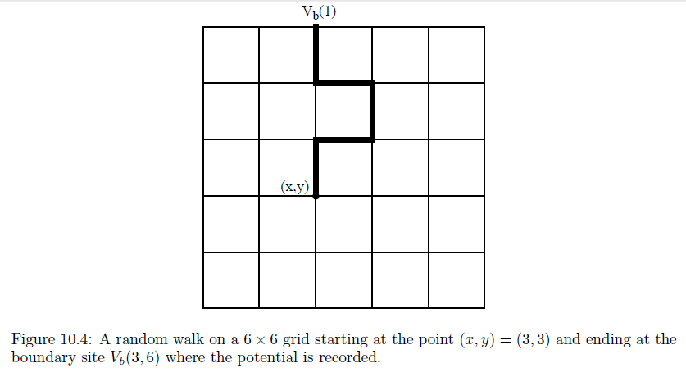

Slide 48
Advantages and disadvantages?

Slide 49
The disadvantage of the random walk method is that it requires many walkers to obtain a good estimate of the potential at each site.
However, if the potential is needed at only a small number of sites, then the random walk method might be more appropriate than the relaxation method which requires the potential to be computed at all points within the region.

Slide 50
Another case where the random walk method is appropriate is when the geometry of the boundary is fixed, but the potential in the interior for a variety of different boundary potentials is needed.
In this case the quantity of interest is G(x, y, x_{b}, y_{b}), the number of times that a walker from the point (x, y) lands at the boundary (x_{b}, y_{b}).
The random walk algorithm is equivalent to the relation
V (x, y) =1/nΣG(x, y, x_{b}, y_{b})V (x_{b}, y_{b}),

Slide 51
where the sum is over all sites on the boundary.
We can use the same function G for different distributions of the potential on a given boundary.
G is an example of a Green’s function, a function that you will encounter in advanced treatments of electrodynamics and quantum mechanics.
Of course, if we change the geometry of the boundary, we have to recompute the function G.

Slide 52
The random walk algorithm can help us gain additional insight into the nature of the solutions of Laplace’s equation.
Suppose that you have a boundary similar to the one shown in Figure next page.
The potentials on the left and right boundaries are V_{L} and V_{R}, respectively.
If the neck between the two sides is narrow, it is clear that a random walker starting on the left side has a low probability of reaching the other side.
Hence, we can conclude that the potential in the interior of the left side is approximately V_{L}, except very near the neck.

Slide 53
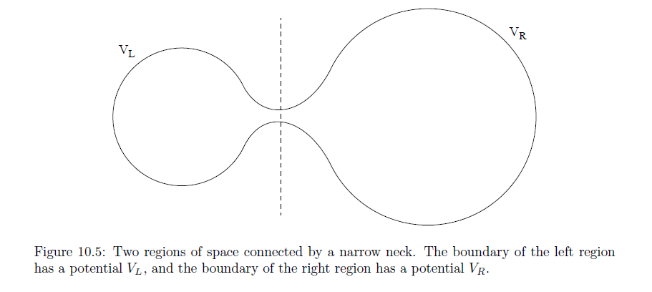

Slide 54
Poisson’s equation also can be solved using the random walk method. In this case, the potential is given by
V (x, y) =(1/n)ΣV (α) +(πΔxΔy/n)Σρ(x_{i; α}, y_{i; α}),
where α labels the walker, and i labels the site visited by the walker.
That is, each time a walker is at site i, we add the charge density at that site to the second sum in the above equation.

